Slide 1
CS112: Introduction to Python programming
Week 10: Pandas I

Slide 2
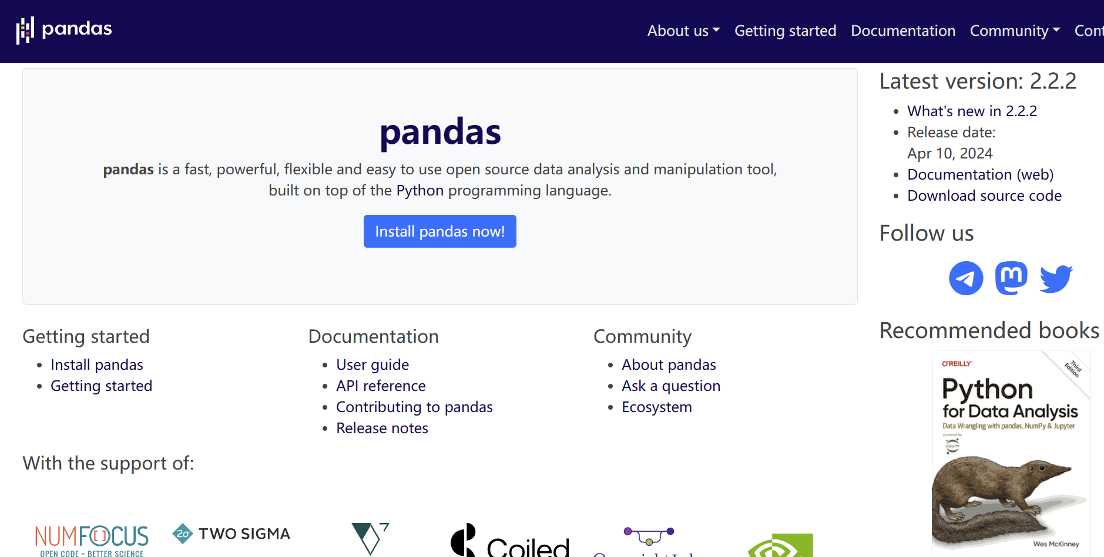
Pandas
pandas is a fast, powerful, flexible and easy to use open source data analysis and manipulation tool, built on top of Numpy.
Install pandas:
conda install pandas
https://pandas.pydata.org/

Slide 3
Pandas-Data Structures
Pandas provides two very useful data structures to process the data:
Series and DataFrame

Slide 4
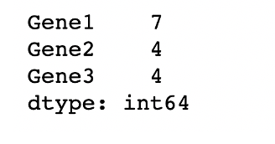
Pandas-Series
Series is a one-dimensional array that can store various data types, including mix data types.
The row labels in a Series are called the index.
Any list, tuple, dictionary and numpy ndarray can be converted into Series using ‘series’ method
The basic method to create a Series is to call:
pd.Series(data, index=index)
index must be the same length as data. If no index is passed, one will be created having values [0, ..., len(data) - 1].

Slide 5
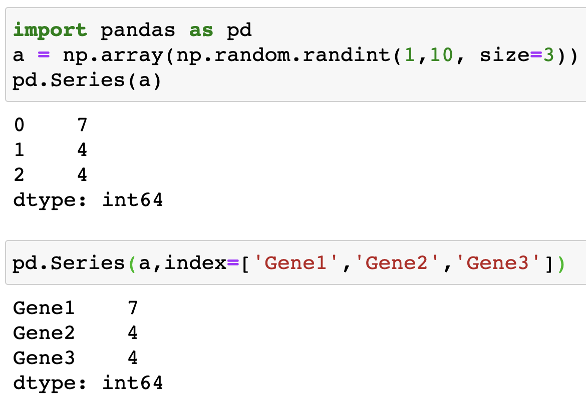
Pandas-Series
From ndarray:

Slide 6
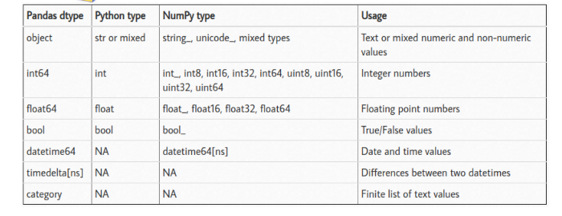
Pandas-dtypes

Slide 7
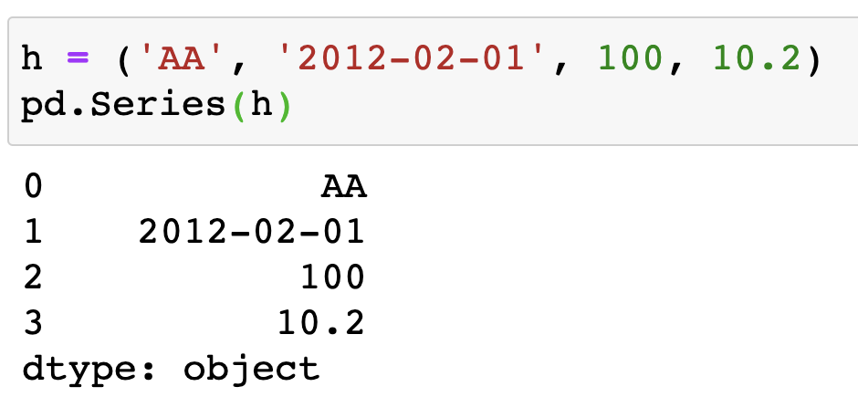
Pandas-Series
From tuples:

Slide 8
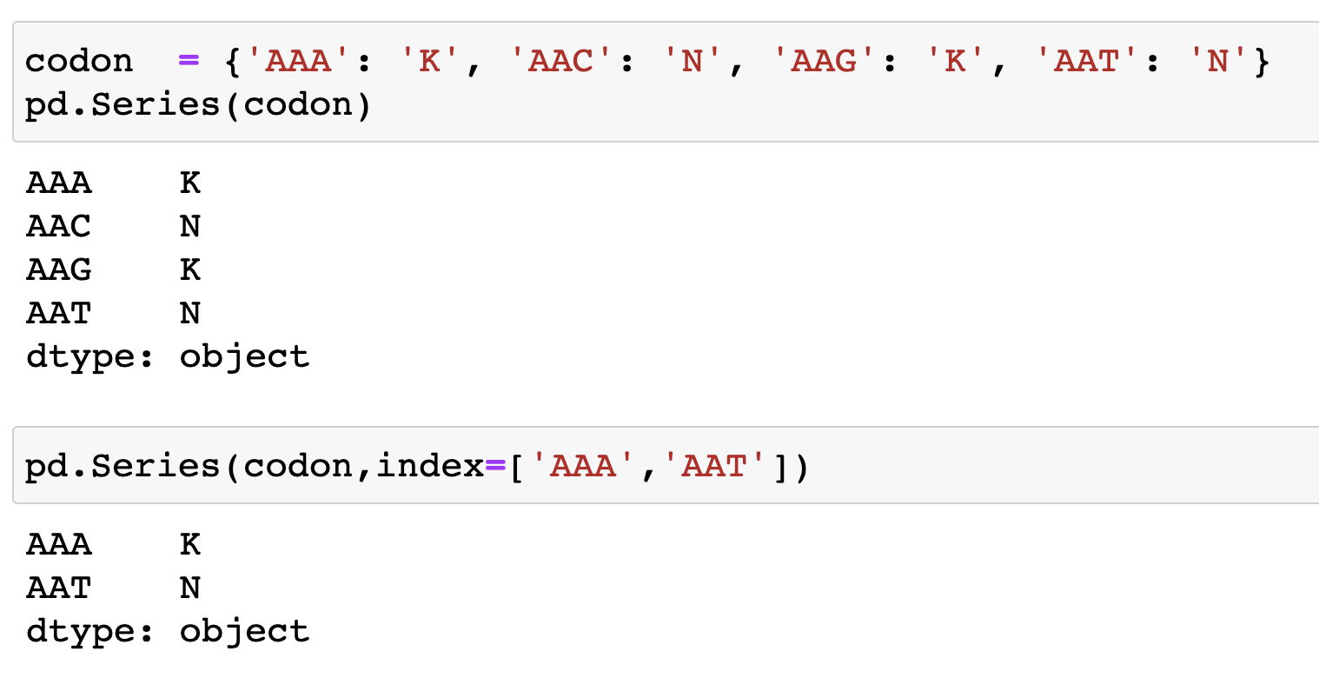
Pandas-Series
From dict:
If an index is passed, the values in data corresponding to the labels in the index will be pulled out.

Slide 9
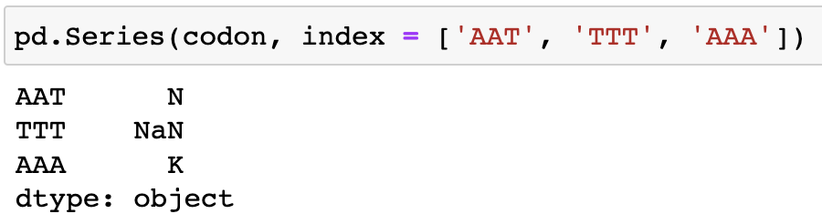
Pandas-Series
From dict:
If a value is not associated for a label, then NaN is printed. NaN (not a number) is the standard missing data marker used in pandas.

Slide 10
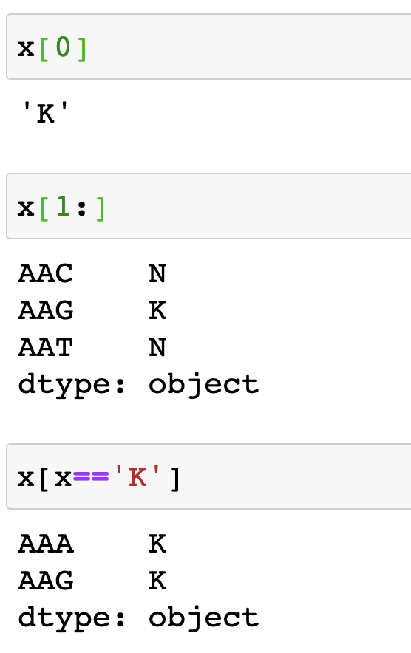
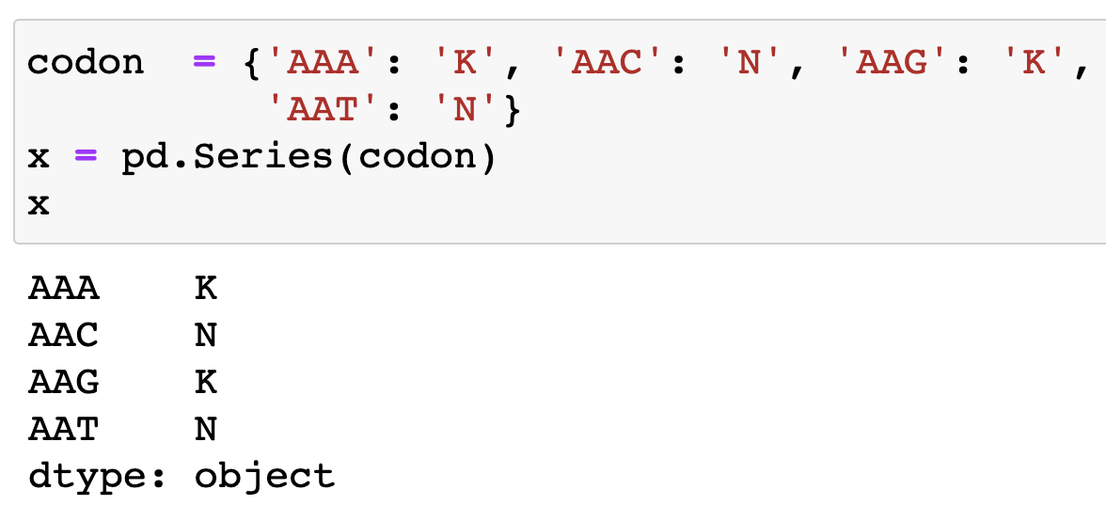
Pandas-Series
Accessing elements in Series:
Series acts very similarly to a ndarray, and is a valid argument to most NumPy functions

Slide 11
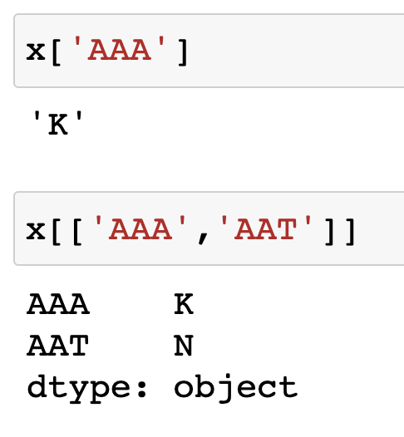
Pandas-Series
Accessing elements in Series:
specific elements can be selected by providing their indexes

Slide 12
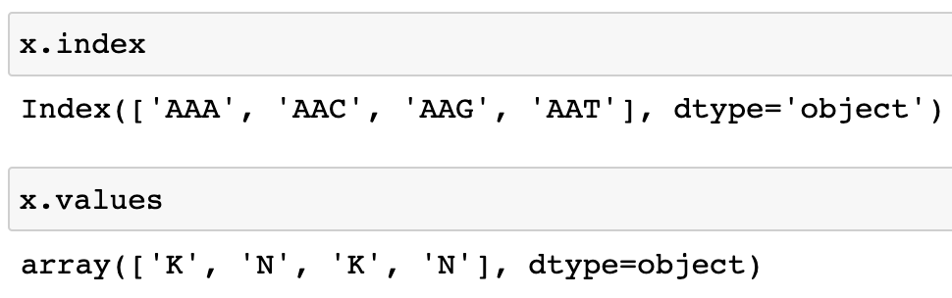
Pandas-Series
Accessing index and values in Series:

Slide 13
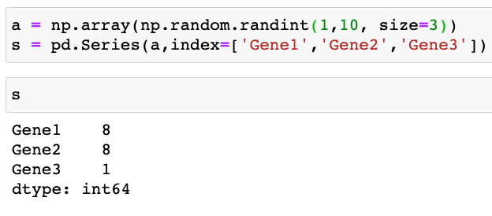
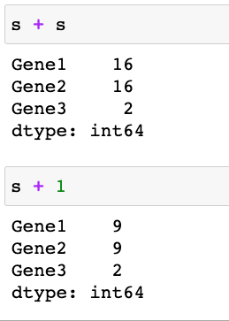
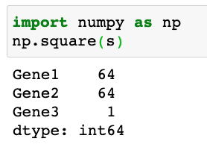
Pandas-Series
Vectorized operations and label alignment with Series
Series can also be passed into most NumPy methods

Slide 14
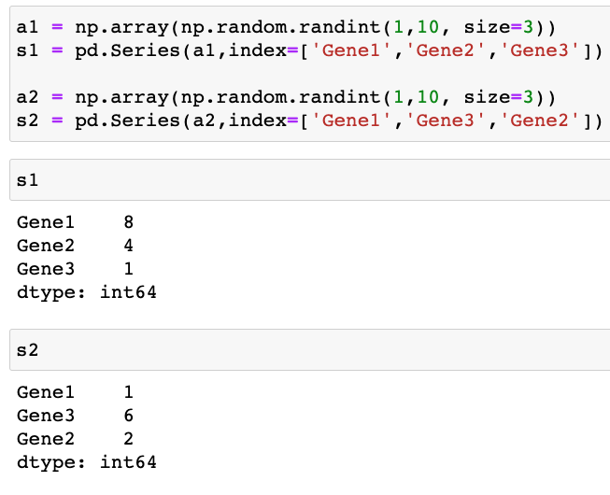
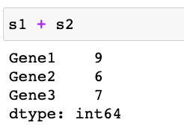
Pandas-Series
Vectorized operations and label alignment with Series
A key difference between Series and ndarray is that operations between Series automatically align the data based on label.

Slide 15
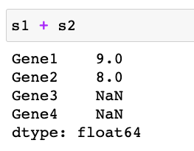
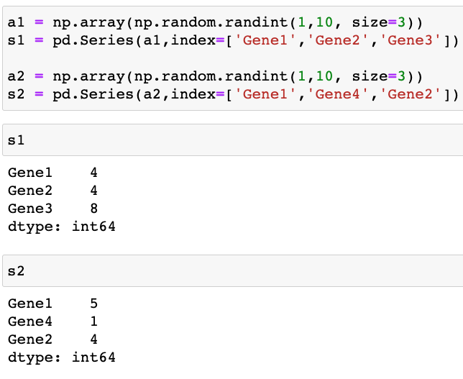
Pandas-Series
Vectorized operations and label alignment with Series
The result of an operation between unaligned Series will have the union of the indexes involved. If a label is not found in one Series or the other, the result will be marked as missing NaN

Slide 16
Pandas-DataFrame
DataFrame is a 2-dimensional labeled data structure with columns of potentially different types. It is generally the most commonly used pandas object.
DataFrame has two different labels i.e. index (row labels) and columns (column labels)
DataFrames can be created using pd.DataFrame() method.

Slide 17
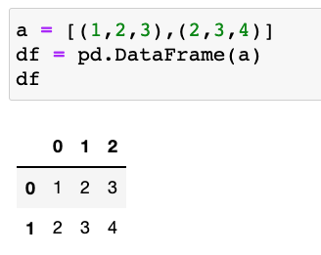
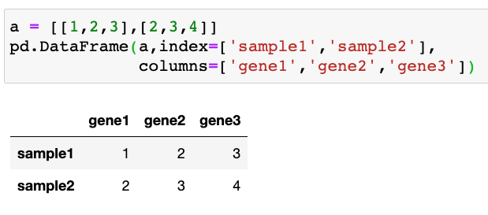
Creating DataFrames
pd.DataFrame(data, (index, columns))
From dict/list of ndarrays / lists / tuples / dict
The ndarrays/lists must all be the same length. If an index is passed, it must also be the same length as the arrays. If no index is passed, the result will be range(n), where n is the array length.

Slide 18
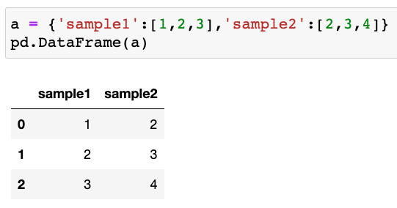
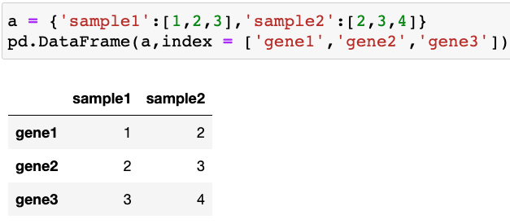
Creating DataFrames
pd.DataFrame(data, (index, columns))
From dict/list of ndarrays / lists / tuples / dict

Slide 19
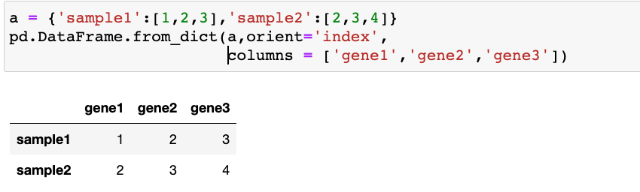
Creating DataFrames
pd.DataFrame.from_dict(data, orient = ‘columns’)
From dict/list of ndarrays / lists / tuples / dict
orient : {'columns', 'index'}, default 'columns’
The "orientation" of the data. If the keys of the passed dict should be the columns of the resulting DataFrame, pass 'columns' (default). Otherwise if the keys should be rows, pass 'index'.

Slide 20
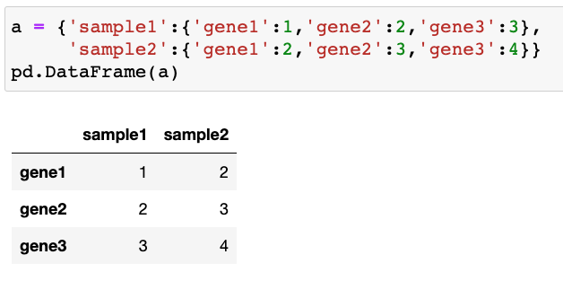
Creating DataFrames
From dict/list of ndarrays / lists / tuples / dict

Slide 21
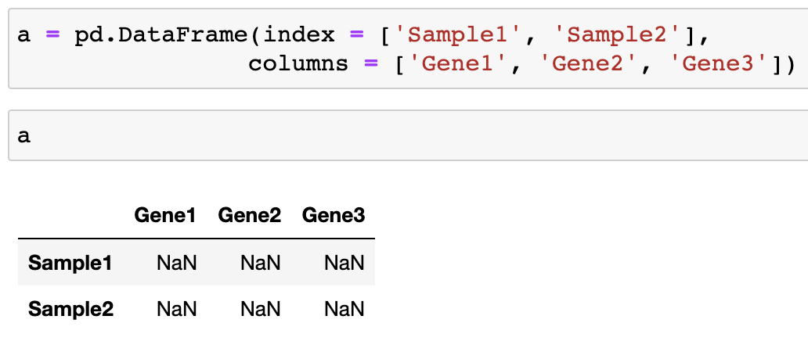
Creating DataFrames
We can also create a DataFrame with empty columns and fill in the data later:

Slide 22
Create DataFrames from files
Format Type | Data Description | Reader | Writer
binary | MS Excel | read_excel | to_excel
binary | OpenDocument | read_excel
binary | HDF5 Format | read_hdf | to_hdf
binary | Feather Format | read_feather | to_feather
binary | Parquet Format | read_parquet | to_parquet
binary | ORC Format | read_orc
binary | Stata | read_stata | to_stata
binary | SAS | read_sas
binary | SPSS | read_spss
binary | Python Pickle Format | read_pickle | to_pickle
SQL | SQL | read_sql | to_sql
SQL | Google BigQuery | read_gbq | to_gbq
Reading and writing files
Format Type | Data Description | Reader | Writer
text | CSV | read_csv | to_csv
text | Fixed-Width Text File | read_fwf
text | JSON | read_json | to_json
text | HTML | read_html | to_html
text | LaTeX |  | Styler.to_latex
text | XML | read_xml | to_xml
text | Local clipboard | read_clipboard | to_clipboard
https://pandas.pydata.org/pandas-docs/stable/user_guide/io.html

Slide 23
Create DataFrames from files
read_csv (filepath, sep=’,’ , header = ‘infer’, names = None, index_col = None,…)
filepath: a path to a file
sep: Delimiter to use; ’ , ’ for CSV, ‘ \t ’ for tab-delimited file
header: Row number(s) to use as the column names. None if file contains no header row
names: List of column names to use
index_col: Column(s) to use as the row labels of the DataFrame, either given as string name or column index.

Slide 24
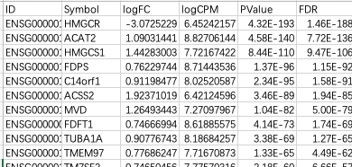
Create DataFrames from files
read_csv (filepath, sep=’,’ , header = ‘infer’, names = None, index_col = None,…)
RNA_seq_results.csv

Slide 25
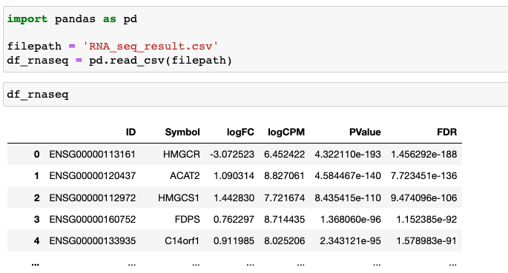
Create DataFrames from files
read_csv (filepath, sep=’,’ , header = ‘infer’, names = None, index_col = None,…)

Slide 26
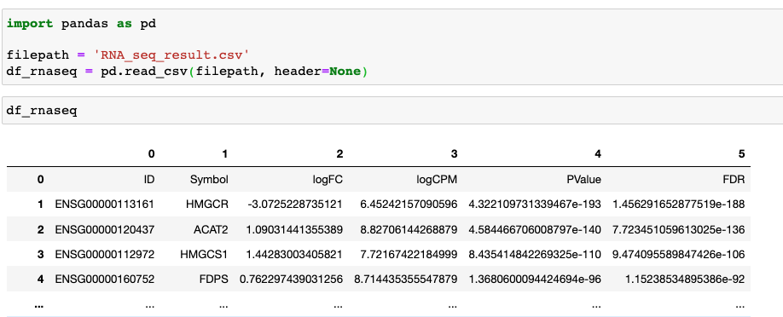
Create DataFrames from files
read_csv (filepath, sep=’,’ , header = ‘infer’, names = None, index_col = None,…)

Slide 27
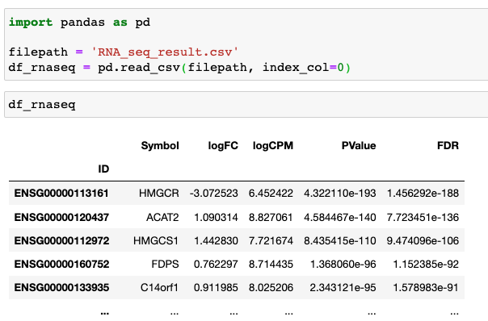
Create DataFrames from files
read_csv (filepath, sep=’,’ , header = ‘infer’, names = None, index_col = None,…)

Slide 28
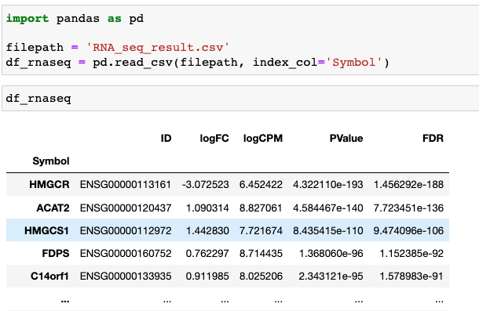
Create DataFrames from files
read_csv (filepath, sep=’,’ , header = ‘infer’, names = None, index_col = None,…)

Slide 29
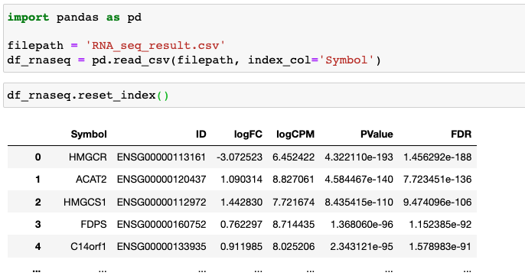
Create DataFrames from files
read_csv (filepath, sep=’,’ , header = ‘infer’, names = None, index_col = None,…)
reset_index()
Reset the index of the DataFrame

Slide 30
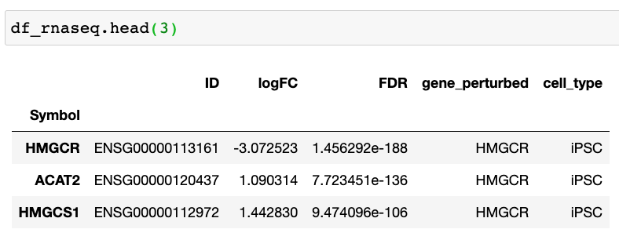
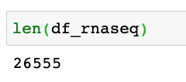
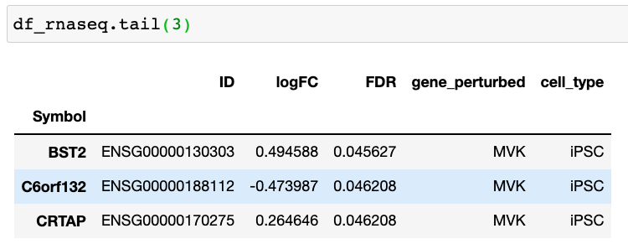
View DataFrames
Use DataFrame.head(n) and DataFrame.tail(n) to view the top and bottom n rows of the frame, respectively.

Slide 31

Save DataFrames to files
DataFrame.to_csv (filepath, sep=’,’ , header = True, index = True, …)
sep : str, default ‘,’ ; ‘\t’ for tab-delimited file
header : bool or list of str, default True. Write out the column names. If a list of strings is given it is assumed to be aliases for the column names.
index : bool, default True. Write row names (index).

Slide 32
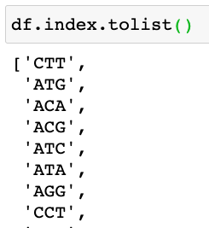
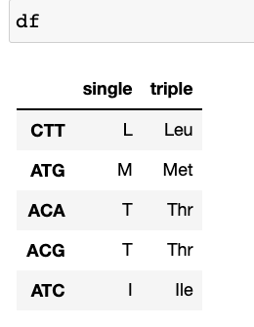
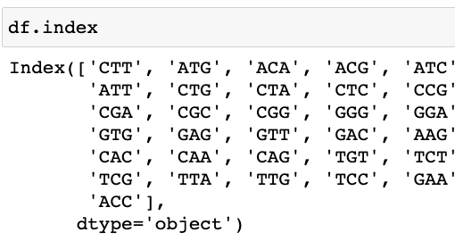

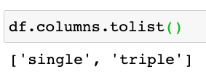
DataFrame indexing and slicing
Get row and column labels: df.index, df.columns

Slide 33
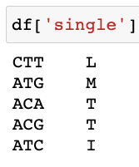
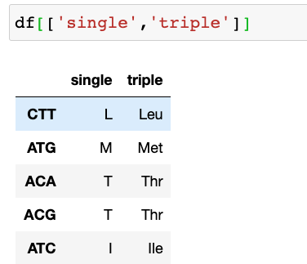
DataFrame indexing and slicing
A DataFrame is like a dict of indexed Series objects.
Row and Column selection
By column name

Slide 34
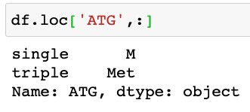
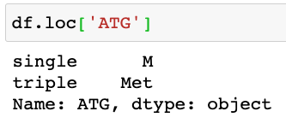
DataFrame indexing and slicing
Row and Column selection
By labels: df.loc[ row_lable, col_label ]

Slide 35
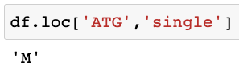
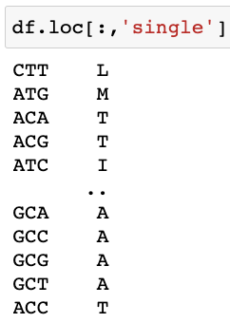
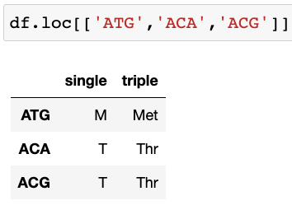
DataFrame indexing and slicing
Row and Column selection
By labels: df.loc[ row_lable, col_label ]

Slide 36
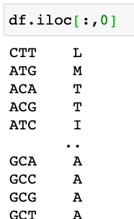
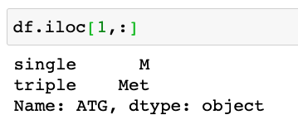
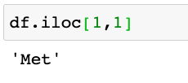
DataFrame indexing and slicing
Row and Column selection
By location: df.iloc[ row_loc, col_loc ]

Slide 37
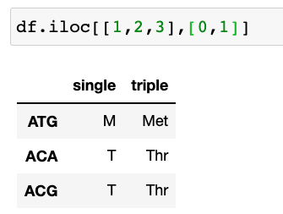
DataFrame indexing and slicing
Row and Column selection
By location: df.iloc[ row_loc, col_loc ]

Slide 38
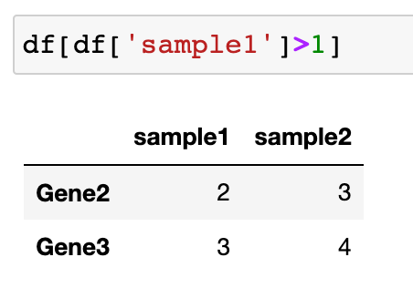


DataFrame indexing and slicing
Data filtering
Boolean indexing

Slide 39


DataFrame indexing and slicing
Data filtering
Boolean indexing
df.isin()

Slide 40


DataFrame indexing and slicing
Data filtering
Various string operations can be performed using ‘.str’

Slide 41

DataFrame indexing and slicing
Data filtering
Various string operations can be performed using ‘.str.’ option

Slide 42

DataFrame indexing and slicing
Data filtering
Various string operations can be performed using ‘.str.’ option

Slide 43


Dealing with missing values
Pandas primarily uses the value np.nan to represent missing data. It is by default not included in computations.
.isna() gets the boolean mask where values are NaN:

Slide 44

Dealing with missing values
Pandas primarily uses the value np.nan to represent missing data. It is by default not included in computations.
.any(axis=0 )
Return whether any element is True, over an axis.
.isna() gets the boolean mask where values are NaN:

Slide 45

Dealing with missing values
Pandas primarily uses the value np.nan to represent missing data. It is by default not included in computations.
.all(axis=0 )
Return whether all elements are True, over an axis.
.isna() gets the boolean mask where values are NaN:

Slide 46



Dealing with missing values
Pandas primarily uses the value np.nan to represent missing data. It is by default not included in computations.
.dropna(axis=0, how=’any’, inplace=False)
drops any rows that have missing data:

Slide 47

Dealing with missing values
Pandas primarily uses the value np.nan to represent missing data. It is by default not included in computations.
.dropna(axis=0, how=’any’, inplace=False)
drops any rows that have missing data:
inplace bool, default False
Whether to modify the DataFrame rather than creating a new one.

Slide 48

Dealing with missing values
Pandas primarily uses the value np.nan to represent missing data. It is by default not included in computations.
.fillna(value=None, axis=None, inplace=False)
Fill NaN values using the specified method.

Slide 49


Modifying DataFrames

Slide 50

Modifying DataFrames

Slide 51

Modifying DataFrames

Slide 52

Modifying DataFrames
.replace(to_replace, value):
Replace values given in to_replace with value.

Slide 53

Modifying DataFrames
Add a new column

Slide 54

Modifying DataFrames
Add a new column

Slide 55

Modifying DataFrames
Add a new column

Slide 56

Modifying DataFrames
Add a new row:

Slide 57


Modifying DataFrames
Delete a row or column
df.drop (labels=None, axis=0, inplace=False,…)

Slide 58

Modifying DataFrames
Delete a row or column
df.drop (labels=None, axis=0, inplace=False,…)

Slide 59



DataFrame attributes and methods
DataFrame.shape
len()

Slide 60


DataFrame attributes and methods
DataFrames Transposing
DataFrame.T

Slide 61

DataFrame attributes and methods
return index / column names

Slide 62

DataFrame attributes and methods
modify index / column names

Slide 63

DataFrame attributes and methods
modify index / column names
DataFrame.reset_index()
Reset the index of the DataFrame, and use the default one instead.

Slide 64


DataFrame attributes and methods
modify index / column names
df.set_index(keys, drop=True, append=False, inplace=False,..)
set the DataFrame index using existing columns.

Slide 65

DataFrame attributes and methods
.value_counts()
Return a Series containing counts of unique rows in the DataFrame.

Slide 66

DataFrame attributes and methods
.tolist(): convert a Pandas Series to a list

Slide 67

DataFrame attributes and methods
.unique(): return unique values

Slide 68


DataFrame attributes and methods
Sorting
df. sort_values(by, axis=0, ascending=True, inplace=False,…)

Slide 69

DataFrame attributes and methods
Sorting
df. sort_values(by, axis=0, ascending=True, inplace=False,…)

Slide 70


DataFrame attributes and methods
.describe(): Generate descriptive statistics.

Slide 71


DataFrame attributes and methods

Slide 72



DataFrame Vectorized operations
Data alignment between DataFrame objects automatically align on both the columns and the index (row labels)

Slide 73


DataFrame Vectorized operations

Slide 74

DataFrame Vectorized operations

Slide 75
参考练习
https://pynative.com/python-pandas-exercise/
https://www.w3schools.com/python/pandas/exercise.asp
https://www.w3schools.com/quiztest/quiztest.asp?qtest=PANDAS

